Slide 1
Linear Algebra
Fundamentals

Slide 2


Machine Learning
Signal Processing
Linear Algebra
Probability/Statistics
Algorithms and Data Structures

Slide 3

Linear algebra is a branch of mathematics which is essential for
The goal of this lecture is not for you to become experts on the topic of linear algebra
But rather for you to become familiarized with the terminology and the intuition behind the principles
Both numeric and geometric
This might be one of the “hardest” topics of the paper
Due to its mathematical novelty
Be patient and try your best
Computer science
Physics
Electrical engineering
Mechanical engineering
Statistics
Economics
Finance
Machine learning
…

Slide 4
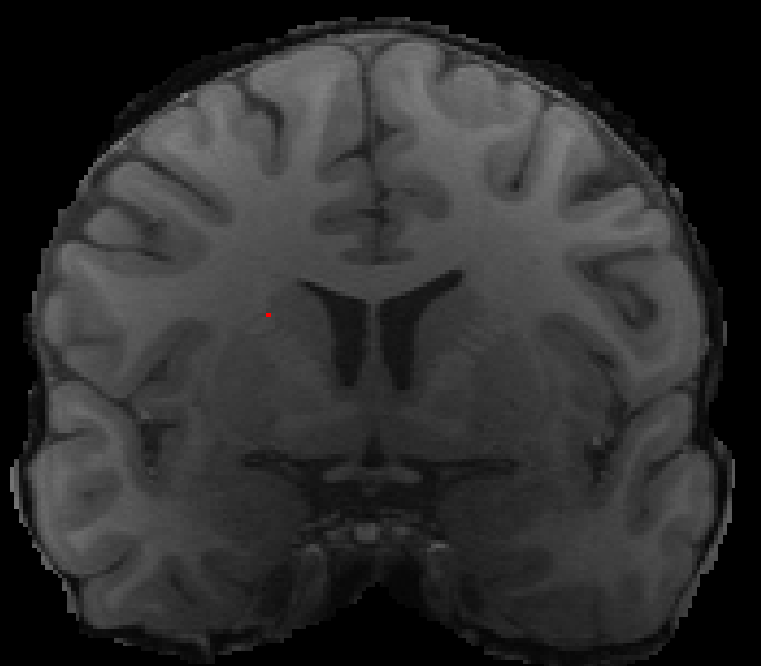
Scalar: a single number
A quantity (variable), described by a single real number (i.e., weight, height, temperature, volume, grade, IQ, income,…)
0
255
e.g. Intensity of a single pixel in an MRI scan

Slide 5
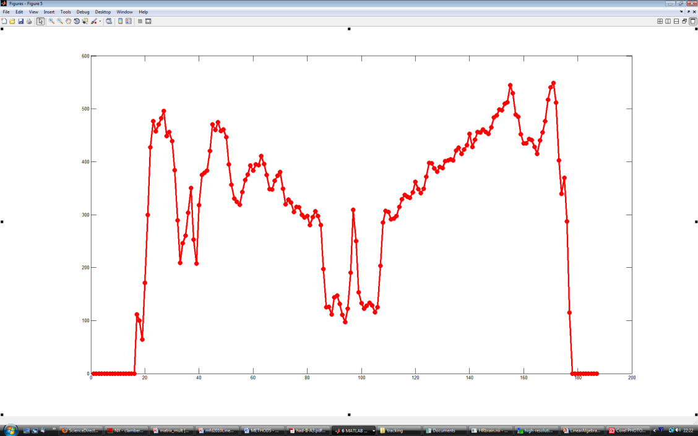
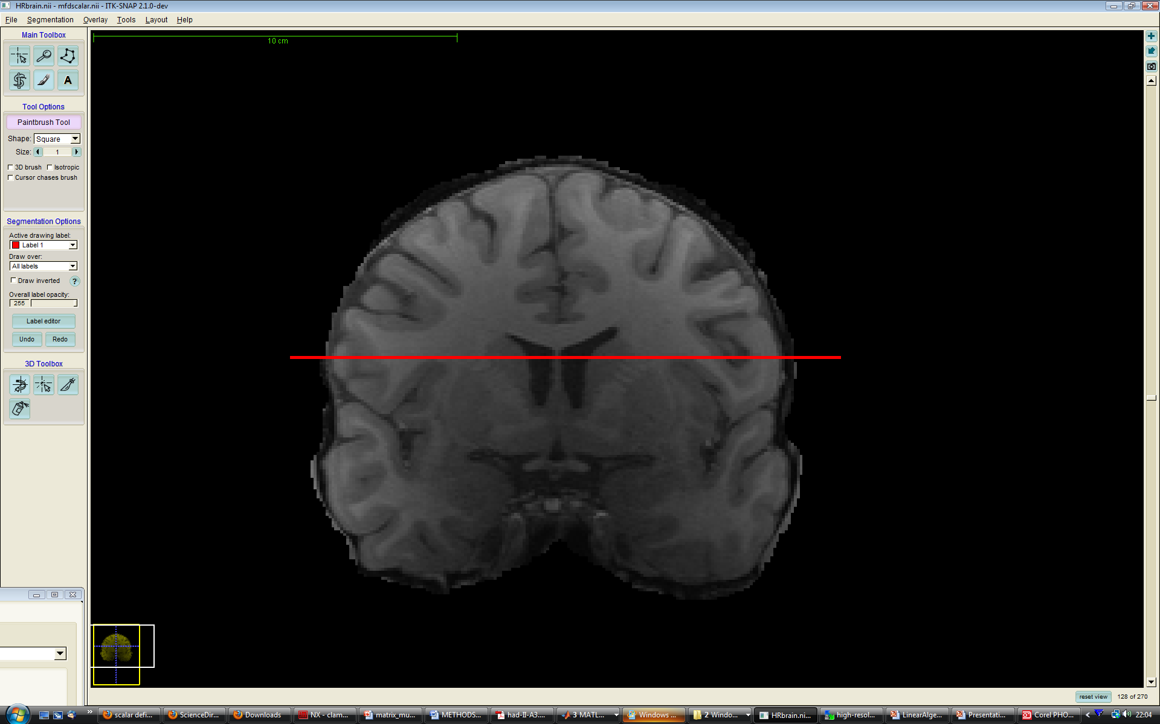
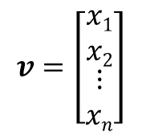
Vector: an array of scalars
EXAMPLE:
$$v=\left[\begin{aligned}\begin{matrix}x1 \\ x2\end{matrix} \\ ⋮ \\ xn\end{aligned}\right]$$

Slide 6
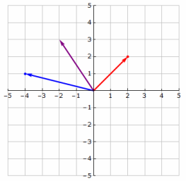
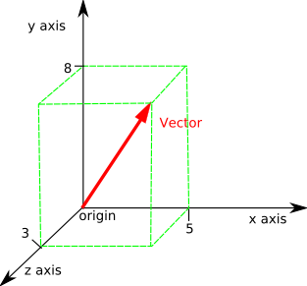
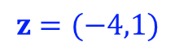
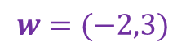
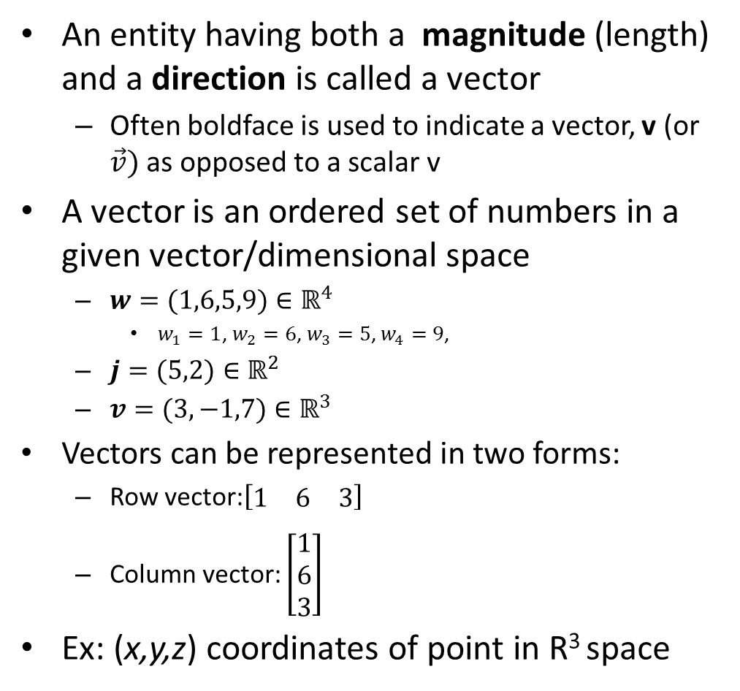
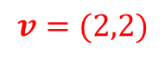
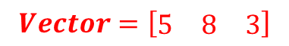
Vectors
An entity having both a magnitude (length) and a direction is called a vector
Often boldface is used to indicate a vector, v (or $\vec{v})$as opposed to a scalar v
A vector is an ordered set of numbers in a given vector/dimensional space
$w=(1,6,5,9)∈ℝ^{4}$
$w_{1}=1$, $w_{2}=6$, $w_{3}=5$, $w_{4}=9$,
$j=(5,2)∈ℝ^{2}$
$v=(3,−1,7)∈ℝ^{3}$
Vectors can be represented in two forms:
Row vector:$\left[\begin{matrix}1 & 6 & 3\end{matrix}\right]$
Column vector: $\left[\begin{matrix}1 \\ 6 \\ 3\end{matrix}\right]$
Ex: (x,y,z) coordinates of point in R³ space
$$v=(2,2)$$
$$z=(−4,1)$$
$$w=(−2,3)$$
$$Vector=\left[\begin{matrix}5 & 8 & 3\end{matrix}\right]$$

Slide 7
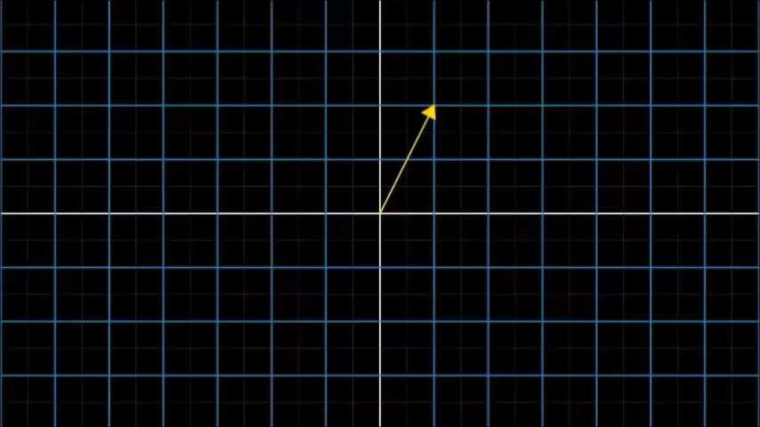
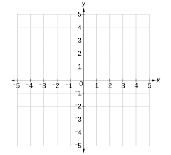
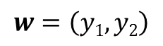
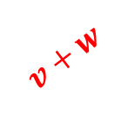
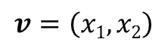



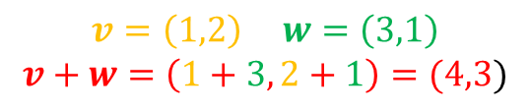

Vector Addition
$$v=\left(x1,x2\right)$$
$$w=\left(y1,y2\right)$$
$$v$$
$$w$$
$$v$$
$$w$$
$$v+w$$
$$v=\left(1,2\right) w=\left(3,1\right)$$
$$v+w=\left(1+3, 2+1\right)=(4,3)$$

Slide 8
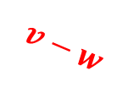


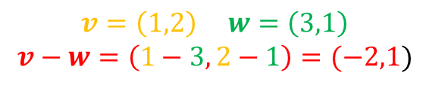
Vector Substraction
Is this stuff actually useful???
$$v=\left(x1,x2\right)$$
$$w=\left(y1,y2\right)$$
YES!
$$v−w=\left(x_{1},x_{2}\right)−\left(y_{1},y_{2}\right)=(x_{1}−y_{1},x_{2}−y_{2})$$
$$v$$
$$v$$
$$w$$
$$v−w$$
$$w$$
$$v=\left(1,2\right) w=\left(3,1\right)$$
$$v−w=\left(1−3, 2−1\right)=(−2,1)$$

Slide 9

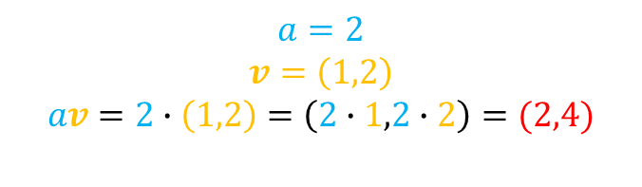


Scalar Product
(stretching or shrinking a vector)
The scalar product of a vector stretches or shrinks or inverts the length (“scaling”) of the vector, but keeps its direction fixed.
av
v
$$av$$
$$v$$
$$a=2$$
$$v=\left(1,2\right)$$
$$av=2∙\left(1,2\right)=\left(2∙1,2∙2\right)=(2,4)$$

Slide 10

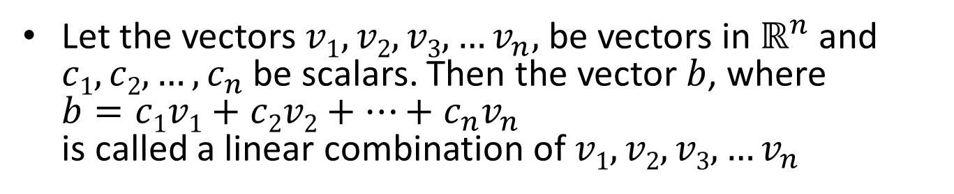
Linear combinations of vectors
Let the vectors $v1,v2,v3,…v_{n},$be vectors in $ℝ^{n}$and $c1,c2,…,c_{n}$ be scalars. Then the vector $b$, where $b=c1v1+c2v2+…+c_{n}v_{n}$ is called a linear combination of $v1,v2,v3,…v_{n}$

Slide 11
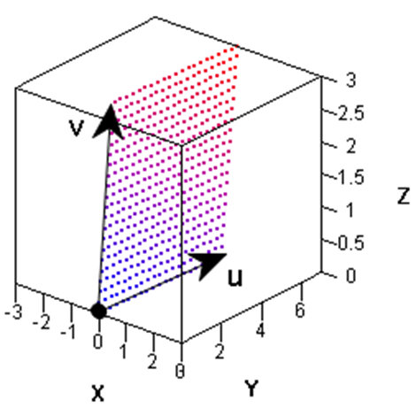
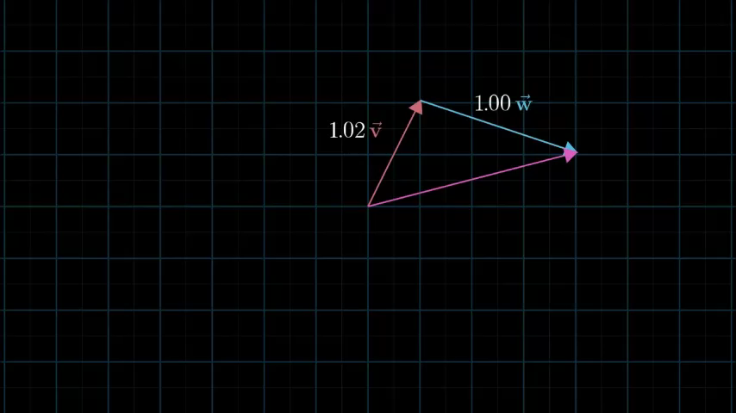
The span of a vector set
The set of all linear combinations of some vectors v₁,…,v_{n} is called the span of these vectors

Slide 12
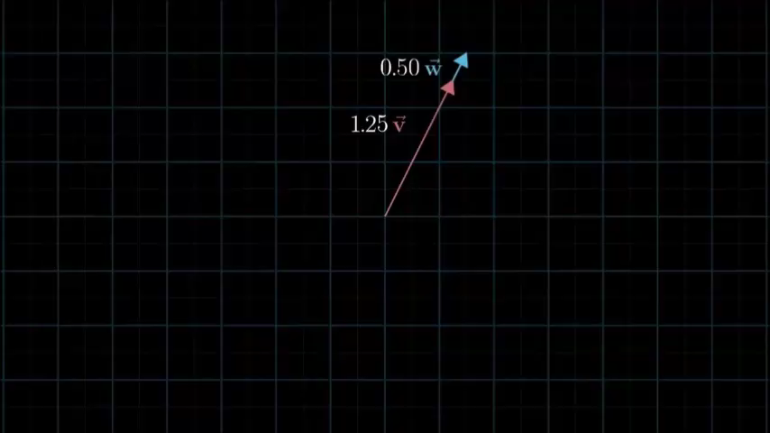
Linear dependence
A set of vectors is said to be dependent if one of the vectors in the set can be defined as a linear combination of the others; if no vector in the set can be written in this way, then the vectors are said to be independent

Slide 13
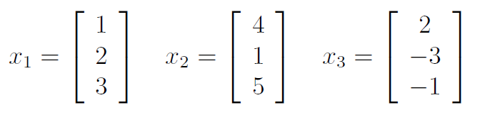
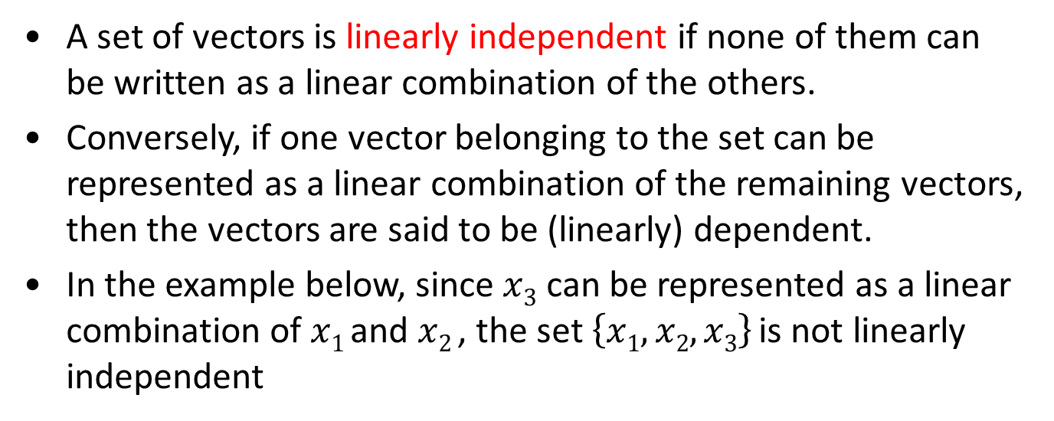
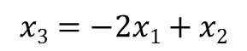
Linear independence
A set of vectors is linearly independent if none of them can be written as a linear combination of the others.
Conversely, if one vector belonging to the set can be represented as a linear combination of the remaining vectors, then the vectors are said to be (linearly) dependent.
In the example below, since $x3$ can be represented as a linear combination of $x1$and $x2$, the set $\left\{x1,x2,x3\right\}$is not linearly independent
$$x3=−2x1+x2$$

Slide 14
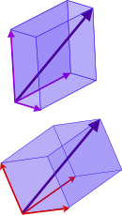
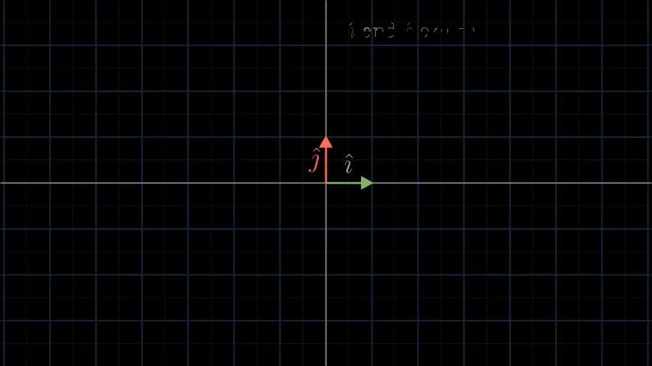
Basis vectors
A set of elements (vectors) in a vector space V is called a basis, or a set of basis vectors, if the vectors are linearly independent and every vector in the vector space is a linear combination of this set
The same vector can be represented in two different basis vectors

Slide 15
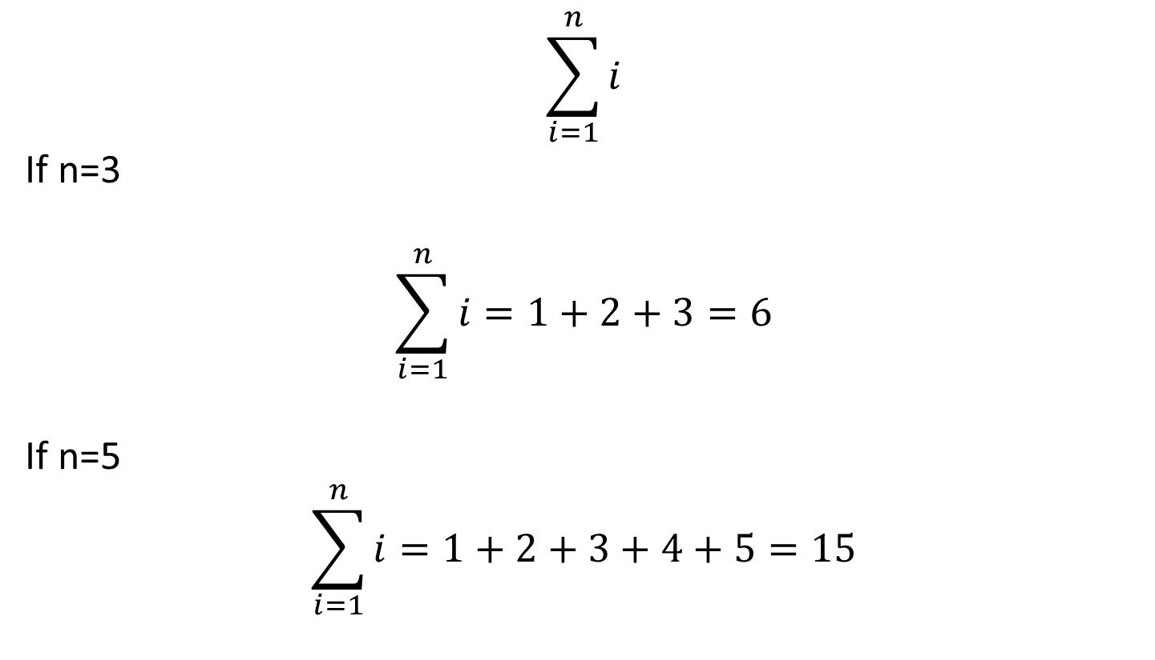

A word about $Σ$notation
$$\sum_{i=1}^{n}{i}$$
If n=3
$$\sum_{i=1}^{n}{i}=1+2+3=6$$
If n=5
$$\sum_{i=1}^{n}{i}=1+2+3+4+5=15$$

Slide 16
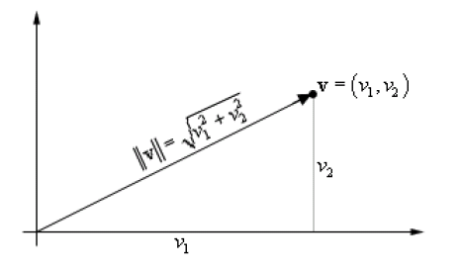
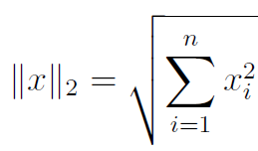
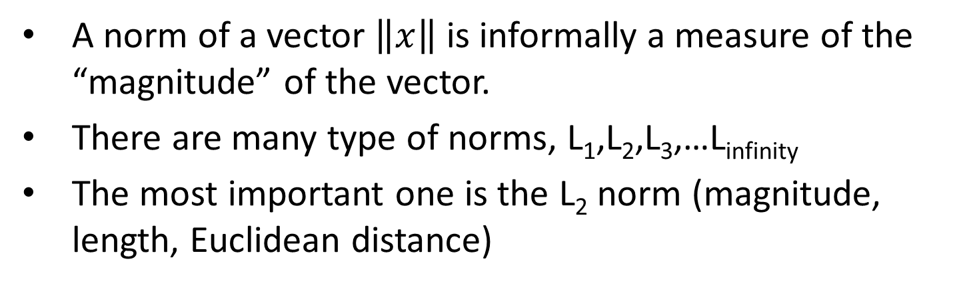
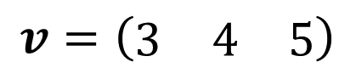
Vector norms
A norm of a vector $\left\|x\right\|$ is informally a measure of the “magnitude” of the vector.
There are many type of norms, L₁,L₂,L₃,…L_{infinity}
The most important one is the L₂ norm (magnitude, length, Euclidean distance)
$$v=\left(\begin{matrix}3 & 4 & 5\end{matrix}\right)$$
$$L2\left(v\right)=\left\|v\right\|2=\left|v\right|=\sqrt[2]{3^{2}+4^{2}+5^{2}}=\sqrt[2]{50}≈7.07$$

Slide 17
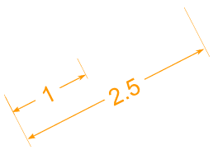
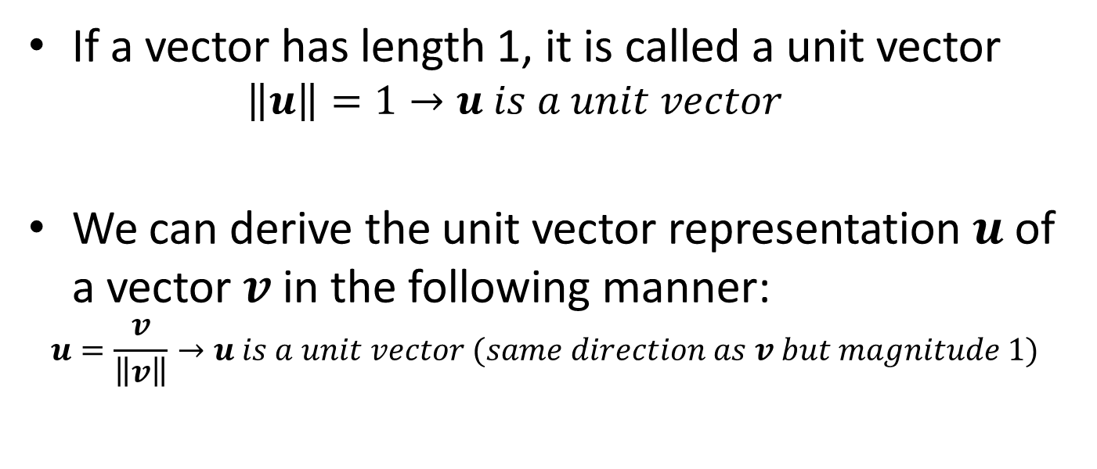

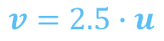
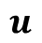
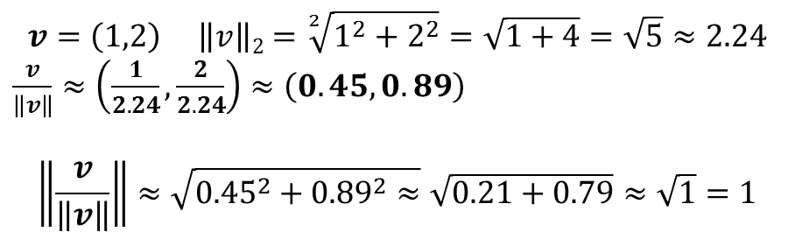
Unit vector
$$v=2.5∙u$$
$$v$$
$$u$$
If a vector has length 1, it is called a unit vector
$$\left\|u\right\|=1→u is a unit vector$$
We can derive the unit vector representation $u$ of a vector $v$in the following manner:
$$u=\frac{v}{\left\|v\right\|}→u is a unit vector (same direction as v but magnitude 1)$$
$$v=\left(1,2\right) \left\|v\right\|2=\sqrt[2]{1^{2}+2^{2}}=\sqrt{1+4}=\sqrt{5}≈2.24$$
$\frac{v}{\left\|v\right\|}≈\left(\frac{1}{2.24},\frac{2}{2.24}\right)≈\left(0.45,0.89\right)$
$$\left\|\frac{v}{\left\|v\right\|}\right\|≈\sqrt{{0.45}^{2}+{0.89}^{2}≈}\sqrt{0.21+0.79}≈\sqrt{1}=1$$

Slide 18
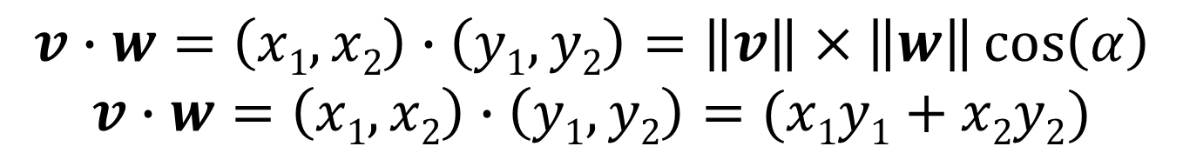
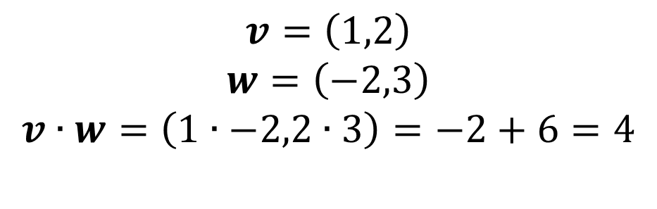
Dot Product aka inner product
v
The inner product of 2 vectors results in a SCALAR!
α
w
$$v∙w=\left(x1,x2\right)∙\left(y1,y2\right)=\left\|v\right\|×\left\|w\right\|\cos\left(α\right)$$
$$v∙w=\left(x1,x2\right)∙\left(y1,y2\right)=(x1y1+x2y2)$$
$$v=\left(1,2\right)$$
$$w=\left(−2,3\right)$$
$$v∙w=\left(1∙−2,2∙3\right)=−2+6=4$$
Please note that this is probably the most important mathematical operation in machine learning!
Notes:
The most important concept of today’s class

Slide 19

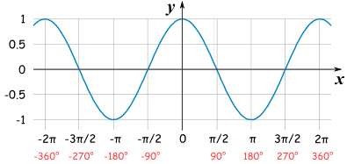
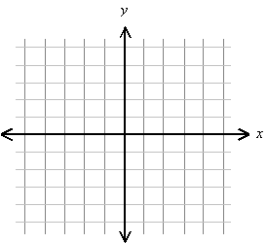
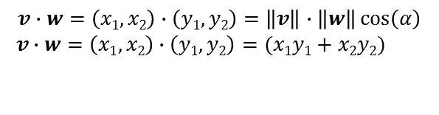
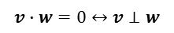
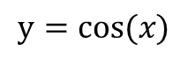
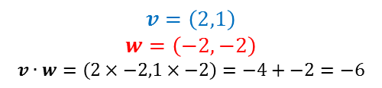
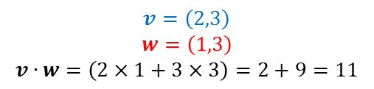
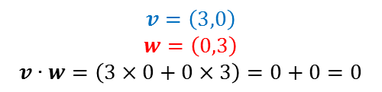
The dot product can be thought of as a tool to determine the similarity between 2 vectors of equal magnitude (i.e. it is a way of measuring to what extent the vectors point in the same direction)
$$y=cos⁡(x)$$
$$v∙w=\left(x1,x2\right)∙\left(y1,y2\right)=\left\|v\right\|∙\left\|w\right\|\cos\left(α\right)$$
$$v∙w=\left(x1,x2\right)∙\left(y1,y2\right)=(x1y1+x2y2)$$
$$v=\left(3,0\right)$$
$$w=\left(0,3\right)$$
$$v∙w=\left(3×0+0×3\right)=0+0=0$$
$$v=\left(2,3\right)$$
$$w=\left(1,3\right)$$
$$v∙w=\left(2×1+3×3\right)=2+9=11$$
$$v=\left(2,1\right)$$
$$w=\left(−2,−2\right)$$
$$v∙w=\left(2×−2,1×−2\right)=−4+−2=−6$$
$$v∙w=0↔v⊥w$$
Notes:
If 2 vectors are orthogonal, their dot product will be 0

Slide 20
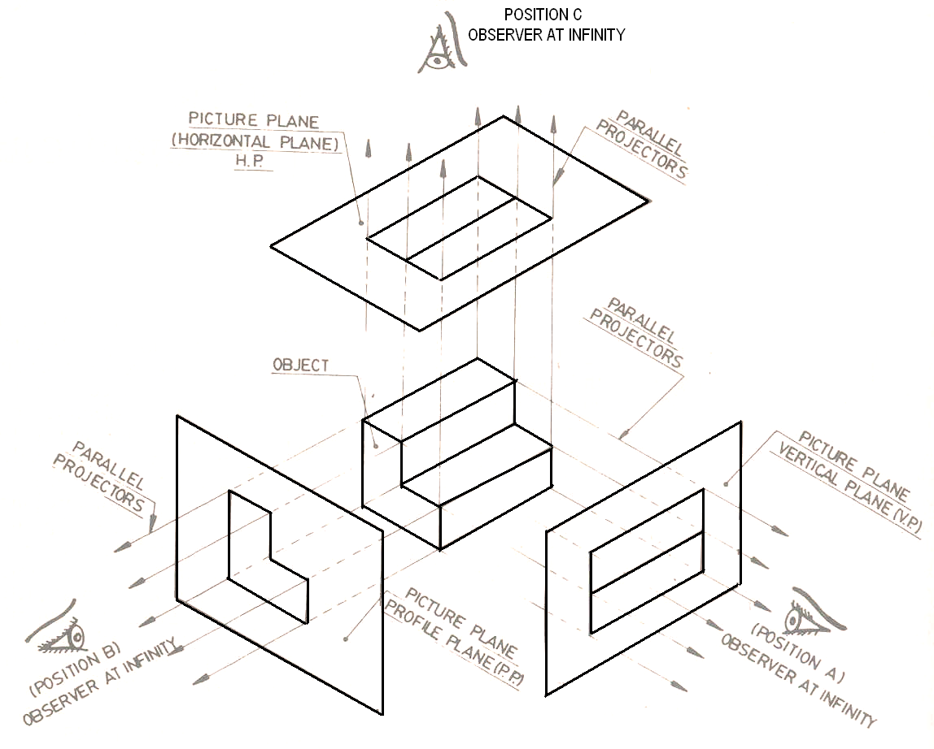





Vector Projection
A projection is the transformation of points and lines in one plane onto another plane by connecting corresponding points on the two planes with parallel lines.
The vector projection of a vector a (on or onto) a nonzero vector b is a vector whose magnitude is the scalar projection of a on b and whose angle against b is either 0 or 180 degrees.
||a|| is the length of a, and is the angle between a and b.
Projecting a point onto a line simply involves finding the location on the line which is closest to the point
In the figure on the right $a_{1}$ is the projection of a into b
$$a_{1}=\left\|a\right\|cosθ=a∙\hat{b}=a∙\frac{b}{\left\|b\right\|}$$
$$a_{1}=a_{1}\hat{b}$$

Slide 21





What is a Matrix?
A matrix is a set of elements, organized into rows and columns (a 2D array for programmers)
A rectangular array of numbers
You can think of it as a sequence of row or column vectors
Dimension of matrix: number of rows x number of columns
rows
$$\left[\begin{matrix}3 & 7 & 2 \\ 5 & 1 & 9\end{matrix}\right]∈ℝ2\text{x}\text{3}$$
$$A11=1$$
$$A=\left[\begin{matrix}1 & 3 \\ 8 & 5 \\ 0 & 6 \\ 7 & 4\end{matrix}\right]∈ℝ\text{4}\text{x}\text{2}$$
columns
$A32=$6
$$A42=4$$
Notes:
A matrix is usually identify with a capital letter in bold
Vector is just a n x 1 matrix

Slide 22

Matrices size/dimensions
Matrix size is defined as number of rows x number of columns (R x C)
Matrices of more than 2 dimensions are also referred to as tensors
Scalar (1 x 1)
Vector(1 x 3)
Rectangular (3 x 2)
Square (3 x 3)
3 dimensional (3 x 3 x 5) matrix or tensor
Notes:
Can inform about the same vector intensity at different times or different voxels at the same time

Slide 23

Basic Matrix Operations
Addition, Subtraction
Matrices need to have the same dimensions in order to carry out matrix addition/subtraction!
Just add elements
Just subtract elements
Cannot be done since matrices dimensions are not equal

Slide 24



Scalar Multiplication
Let A = (a_{ij}) denote an n × m matrix and let c be any scalar. Then cA is the matrix
$$cA=\left(ca_{ij}\right)=\left[\begin{matrix}ca_{11} & ⋯ & ca_{1n} \\ ⋮ & ⋱ & ⋮ \\ ca_{m1} & ⋯ & ca_{mn}\end{matrix}\right]$$
$$3\text{∙}\left[\begin{matrix}1 & 0 \\ 2 & 5 \\ 3 & 1\end{matrix}\right]=\left[\begin{matrix}3 & 0 \\ 6 & 15 \\ 9 & 3\end{matrix}\right]$$
$$\left[\begin{matrix}4 & 0 \\ 6 & 3\end{matrix}\right]∙\frac{1}{4}=\frac{\left[\begin{matrix}4 & 0 \\ 6 & 3\end{matrix}\right]}{4}=\left[\begin{matrix}1 & 0 \\ 1.5 & 0.75\end{matrix}\right]$$

Slide 25










Matrix-vector multiplication: Dot product every row in $A$ with the column vector $x$
$$\left[\begin{matrix}1 & 3 \\ 4 & 0 \\ 2 & 1\end{matrix}\right]\left[\begin{matrix}1 \\ 5\end{matrix}\right]=\left[\begin{matrix}16 \\ 4 \\ 7\end{matrix}\right]$$
$$1×1+3×5=16$$
$$4×1+0×5=4$$
$$2×1+1×5=7$$
Notice: The number of columns in matrix A must coincide with the number of rows in vector x in order to carry out the product

Slide 26


Matrix multiplication interpreted as a linear transformation of space
Linear transformation of space
All lines must remain lines without getting curved
The origin of coordinates must remain fixed in place

Slide 27



Matrices as linear transformations
(stretching)
(90 degree rotation)
(reflection)
(projection)
(counterclockwise rotation by angle $θ)$
Notes:
commonly used matrix operations in machine learning (and computer graphics)

Slide 28

Linear transformations that squeeze space: dimensionality reduction

Slide 29


Matrix multiplication: a sequence of linear transformations condensed in one single linear transformation
[W,s,v] = svd((repmat(sum(x.*x,1),size(x,1),1).*x)*x');

Slide 30

Matrix multiplication
When A is a mxn matrix & B is a kxl matrix, AB is only possible if n=k (columns in A = rows in B)
1st Matrix
2nd Matrix
Critical insight:
Dot product each row in 1st matrix by each column in 2nd matrix
The row index of the 1st matrix and the column index of the 2nd matrix indicates the location of the dot product in the output matrix
Output Matrix
Notes:
30

Slide 31








Examples
$$\left[\begin{matrix}1 & 3 \\ 2 & 5\end{matrix}\right]\left[\begin{matrix}0 & 1 \\ 3 & 2\end{matrix}\right]=\left[\begin{matrix}9 & 7 \\ 15 & 12\end{matrix}\right]$$
$ℝ2$^{x2}
$ℝ2$^{x2}
$ℝ2$^{x2}
$$\left[\begin{matrix}1 & 3 & 2 \\ 4 & 0 & 1\end{matrix}\right]\left[\begin{matrix}1 & 3 \\ 0 & 1 \\ 5 & 2\end{matrix}\right]=\left[\begin{matrix}11 & 10 \\ 9 & 14\end{matrix}\right]$$
$ℝ2$^{x3}
$ℝ3$^{x2}
$ℝ2$^{x2}

Slide 32


Matrix multiplication properties
Matrix multiplication is NOT commutative i.e the order matters!
In general AB≠BA
Matrix multiplication IS associative
A(BC)=(AB)C
Matrix multiplication IS distributive
A(B+C)=AB+AC
(A+B)C=AC+BC

Slide 33




Why are matrices multiplication relevant for machine learning?
Notes:
The simplest possible class of neural network, one with only an input layer and an output layer. Such a network simply tries to separate the two classes of data by dividing them with a line. Modern neural networks generally have multiple layers between their input and output, called “hidden” layers. At the very least, they have one. We can visualize the behavior of this network by looking at what it does to different points in its domain. It separates the data with a more complicated curve than a line.
We can apply the same technique to understand more complicated networks. For example, a network that classifies two spirals that are slightly entangled, using four hidden layers. Over time, we can see it shift from the “raw” representation to higher level ones it has learned in order to classify the data. While the spirals are originally entangled, by the end they are linearly separable.

Slide 34


The transpose of a matrix
Consider the n × m matrix, A
A^{T} (sometimes indicated with A’) is called the transpose of A when A_{ij}=A^{t}_{ji}
Basically, to transpose A into A^{T} transform every row of A into a column of A^{T}

Slide 35



Identity Matrix
A special matrix which plays a similar role as the number 1 in scalar (single number) multiplication
An n × n identity matrix, I, is the square matrix
Note:
$$I_{3}=\left[\begin{matrix}1 & 0 & 0 \\ 0 & 1 & 0 \\ 0 & 0 & 1\end{matrix}\right]$$
AI = A
IA = A.
$$I_{2}=\left[\begin{matrix}1 & 0 \\ 0 & 1\end{matrix}\right]$$
Worked example
A I₃ = A
for a 3x3 matrix:
1 | 2 | 3 |  | 1 | 0 | 0 |  | 1+0+0 | 0+2+0 | 0+0+3
4 | 5 | 6 | X | 0 | 1 | 0 | = | 4+0+0 | 0+5+0 | 0+0+6
7 | 8 | 9 |  | 0 | 0 | 1 |  | 7+0+0 | 0+8+0 | 0+0+9
$$=\left[\begin{aligned}\begin{aligned}\begin{matrix}\begin{matrix}1 & 2 & 3 \\ 4 & 5 & 6 \\ 7 & 8 & 9\end{matrix} \end{matrix}\end{aligned}\end{aligned}\right]=A$$

Slide 36


The trace of a square matrix
Let A denote a n × n matrix
the trace of the n-by-n square matrix A is defined to be the sum of the elements on the main diagonal (the diagonal from the upper left to the lower right)
$$A=\left(a_{ij}\right)=\left[\begin{matrix}a_{11} & ⋯ & a_{1n} \\ ⋮ & ⋱ & ⋮ \\ a_{m1} & ⋯ & a_{mn}\end{matrix}\right]$$
Then
$$3−2+5=6$$

Slide 37

The inverse of an n × n matrix
Let A denote the n × n matrix
A must be square (number of rows equal number of columns) for A⁻¹ to exist
$$A=\left(a_{ij}\right)=\left[\begin{matrix}a_{11} & ⋯ & a_{1n} \\ ⋮ & ⋱ & ⋮ \\ a_{m1} & ⋯ & a_{mn}\end{matrix}\right]$$
Let B denote an n × n matrix such that
AB = BA = I,
If the matrix B exists then A is called invertible Also B is called the inverse of A and is denoted by A⁻¹

Slide 38








Not all numbers have an inverse. The number 0 does not have an inverse
$$x^{−1}=\frac{1}{x}$$
$$3∙3^{−1}=3∙\frac{1}{3}=\frac{3}{3}=1$$
$$0∙0^{−1}=0∙\frac{1}{0}=Undefined$$
$$3^{−1}=\frac{1}{3}$$
Matrix inverse:
If A is an m x m square matrix, and if it has an A⁻¹ inverse,
1 | 1 | X | 2 3 | -1 3 | = | 2 + 1 3 3 | -1 + 1 3 3 | = | 1 | 0
-1 | 2 |  | 1 3 | 1 3 |  | -2+ 2 3 3 | 1 + 2 3 3 |  | 0 | 1
$$A$$
$$A^{−1}$$
$${AA}^{−1}$$
$$I$$
Notes:
Not essential notes:
For a matrix to be invertible, its determinant has to be non-zero
A matrix that is not invertible is said to be singular

Slide 39

Matrix inverse as an inverse transformation

Slide 40
The inverse of an 2 × 2 matrix
Computing the inverse of a 2 x 2 dimensional matrix is trivial.
Computing the inverse of matrices with large numbers of dimensions is computationally very expensive
Sometimes, prohibitively expensive
This has important implications in numerical computing

Slide 41







Why is all this relevant?
In machine learning, data is often represented as a matrix of rows and columns
Some Machine learning algorithms often try to find solutions of systems of equations that are often represented as matrices
Solving those systems of equations means finding the optimal weights(w)/parameters ($θ$) to minimize a cost function (i.e. Fit the model to the data)
$$X$$
$$y$$
$$X$$
$$θ$$
$$y$$
$$\left(\begin{matrix}1 & 1 & 2 \\ 3 & −2 & 4 \\ 1 & −1 & −1\end{matrix}\right)\left(\begin{matrix}θ1 \\ θ2 \\ θ3\end{matrix}\right)=\left(\begin{matrix}0 \\ 9 \\ 0\end{matrix}\right)$$
$$Xθ=y$$
$$θ=X^{−1}y$$

Slide 42


Determinant of a Matrix
The determinant of a square matrix A ∈ R^{nxn}, is a function det : R^{nxn} → R, and is denoted by |A| or det A
Used for inversion. If det(A) = 0, then A has no inverse A⁻¹ (some of the rows or the columns of the matrix are not linearly independent, i.e the matrix is rank-deficient
Given a matrix A, consider the set of points S ⊂ R^{n} formed by taking all possible linear combinations of the row vectors a₁, . . . , a_{n} ∈ R^{n} of A, where the coefficients of the linear combination are all between 0 and 1. The absolute value of the determinant of A, it turns out, is a measure of the “volume” of the set S.
$S=\left\{v∈ℝ^{n}:v=\sum_{i=i}^{n}{αixi, where 0≤αi≤1, i=1,…,n}\right\}$
For matrices with more than 2 rows and columns, the calculation of the determinant by hand is quite elaborate, so software libraries are used

Slide 43

The determinant of a matrix

Slide 44



Why is linear algebra important for machine learning?
A GPU is a type of CPU optimized for matrix algebra operations

